Slide 1
Healthy lifestyle. Your choice!
Volkhonskaya N. 8A

Slide 2
You know a lot about living a healthy lifestyle, but what does that mean? In general, a healthy person doesn't smoke, he is at a healthy weight, eats healthy food and does exercises. It sounds simple, doesn't it?

Slide 3
The secrets of a healthy lifestyle
A healthy mind in a healthy body

Slide 4
Secrets of healthy eating
Eating a healthy diet is a part of healthy lifestyle. You should eat more fruit and vegetables.

Slide 5
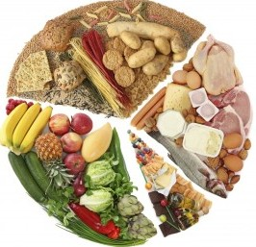
Eat moderately – even much of a good food can be bad
Balance – a balanced diet increases the mental capacity
Variety – if we eat a wide variety of foods, our organism can get all the vitamins we need.
Vitamins are essential for a healthy life. If you follow these guidelines, you can eat whatever your heart desires!

Slide 6
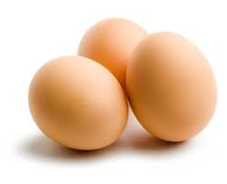
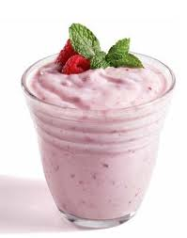
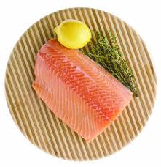
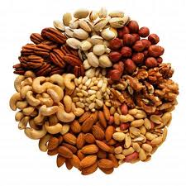
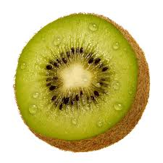
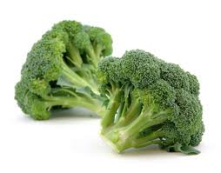
The Super Foods:
1. Eggs
2. Yogurt
3. Nuts
4. Kiwi
5. Fish
6. Beans
7.Salmon
8.Broccoli
9. Sweet potato
10. Berries
All the 10 super foods are easy to obtain.They are delicious, inexpensive and provide benefits to our health.

Slide 7
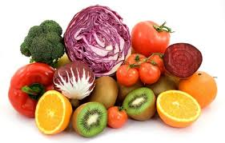
5 reasons to eat fruits and vegetables
They are nourishing and tasty!
They are unique – each of them tastes differently
They contain plenty of vitamins and minerals
Fruits and vegetables are high in fiber, which gives us satiety and helps digestion .
Eating them sufficiently can prevent several diseases

Slide 8
A healthy mind in a healthy body One of the biggest problems today is lack of activity. We know it's good for us but avoid it. The truth is, movement is life and the more you do, the healthier you'll be. Even moderate activities like chores, gardening and walking can make a difference.

Slide 9
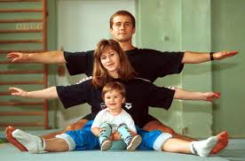
Sport
Exercising is necessary for a healthy life, but don’t overdo with it!
Exercising makes you feel well
Exercising in fresh air is good for brain
Exercising relieves stress, helps to overcome troubles and makes you happy
Some forms of sports do not require much effort,so everyone can find sport of their likings

Slide 10
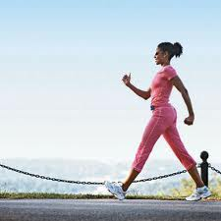
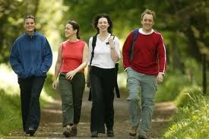
Simple Ways to Move Your Body
You can start the process of weight loss now by adding a little more activity to your life,because it burns more calories.
Turn off the TV. Once a week, turn off the TV and do something a little more physical with your family. Play games, take a walk...it will be more active than sitting before TV.
Walk more. Look for small ways to walk more.

Slide 11
Do some chores. Shoveling snow, working in the garden, raking leaves, sweeping the floor...these kinds of activities may not be 'vigorous' exercise, but they can keep you moving while getting your house in order.
Be aware. Make a list of all the physical activities you do on a typical day. If you find that the bulk of your time is spent sitting, make another list of all the ways you could move more--getting up each hour to stretch or walk, walk the stairs at work, etc.

Slide 12
Nobody’s perfect
The society and environment affects our lifestyles, so it is very important to be kind and friendly to everyone
No one is born into this realm, as they wouldn’t wish
No one should be cast out of the company of others because of their looks, race or wealth – it’s low.
Everyone has a soul, even animals

Slide 13
Consumption of alcohol and tobacco damages health
A person who smokes or drinks alcohol is harmful to others.
Smoking can result in getting cancer.

Slide 14
Sleep is sweeter than honey...
Sleeping sufficiently is an important component of a healthy lifestyle
An average adult needs about 7-8 hours of sleep per a day
Children need to sleep more, infants sleep the most.
The need to sleep decreases as we age
And most importantly – it’s pleasant to sleep

Slide 15
Smile and the world will smile back to you...
Happiness is the key to life
Every smile adds 5 minutes to your life

Slide 16
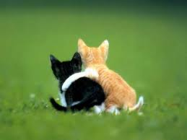
Friends
Good mood and being friendly attracts others
Friends are necessary for a good life
They help you when the times are rough and they always understand you
Thanks to your friends, you are happy and enjoy even little things

