Slide 1
PAST SIMPLE
( Простое прошедшее время)

Slide 28
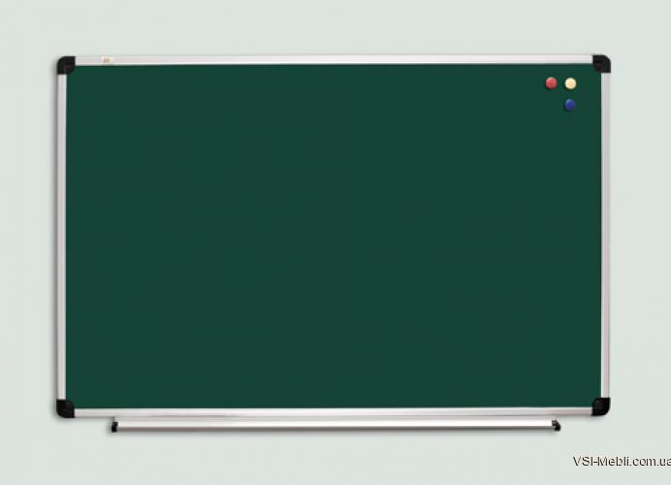
III Составьте вопросы к выделенным словам.
1. At half past twelve Miss Green stopped her work and went out to lunch. 2. Little Kate liked a lot of sugar in her tea. 3. Yesterday I had dinner with a friend of mine. 3. He came home late at night. 4. This morning I listened to the eight o’clock news. 5. They went out together to the cinema.

