Slide 1
Food and drinks
Сурина Валентина
239-555-049

Slide 2
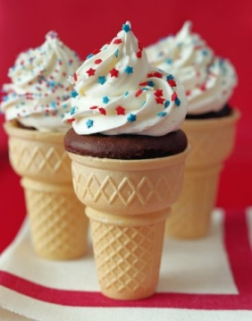
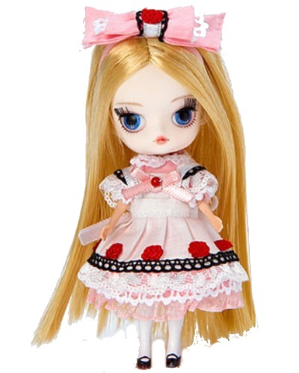
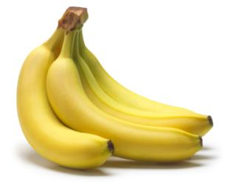
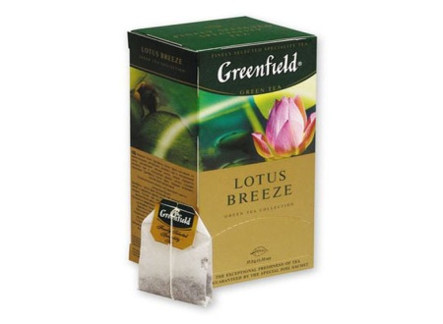
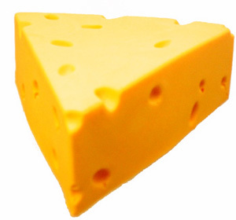
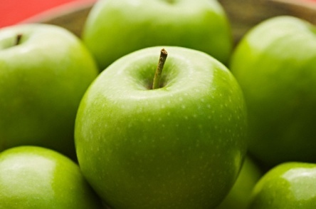
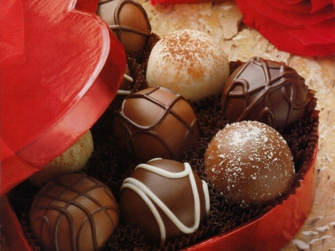
Alice

Slide 3
ice-cream

Slide 4
sweets

Slide 5
cakes

Slide 6
bananas

Slide 7
apples

Slide 8
lemons

Slide 9
cheese

Slide 10
bread

Slide 11
eggs

Slide 12
meat

Slide 13
fish

Slide 14
tea

Slide 15
milk

Slide 16
juice

Slide 17
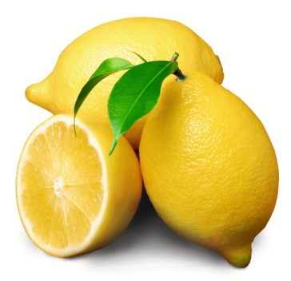
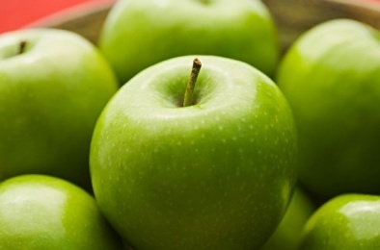
Kate
lemons
apples
bananas
cheese

Slide 18
Kate
bananas
cheese
lemons
apples

Slide 19
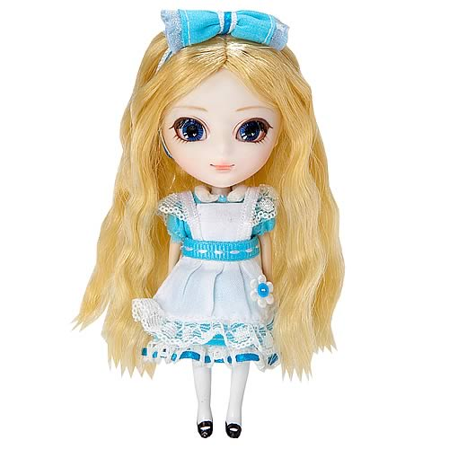
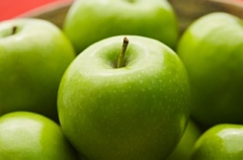
Alice and Kate
Do you like apples?
Yes, I do.
Do you like lemons?
No, I don`t.

Slide 20
Look and remember!
Yes, I do.
Do you like ____ ?
No, I don`t.

Slide 21
The song “Do you like apples?”
Do you like apples?
Yes, I do.
Do you like lemons?
No, I don`t.
Do you like cakes?
Yes, I do.
Do you like bread?
No, I don`t.
Do you like juice?
Yes, I do.
Do you like tea?
No, I don`t.

Slide 23
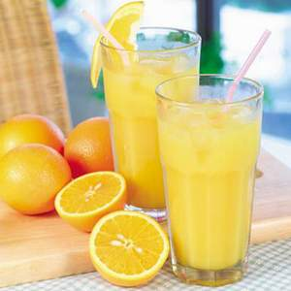
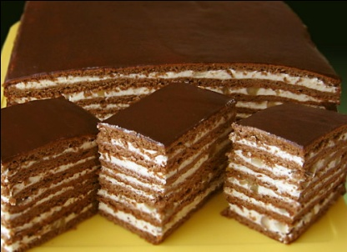
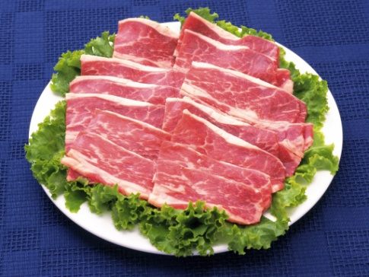
Look and find!
applesbananasjuicecakesmeatsweets

Slide 24
Look and find!
applesbananasjuicecakesmeatsweets

Slide 25
What do you like?
Hello! My name is _____ .
I like ________________ .
I don`t like ___________ .
My favourite food is ____ .
Good Bye!

Slide 26
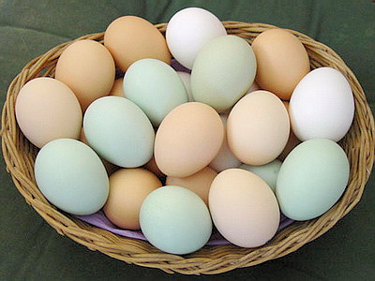
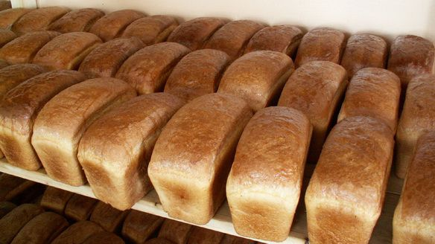
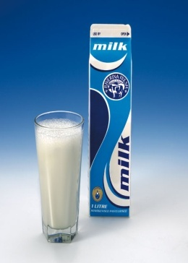
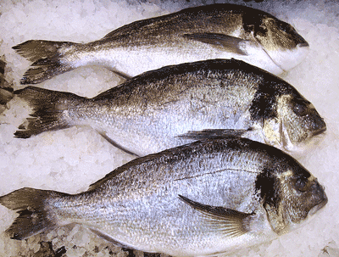
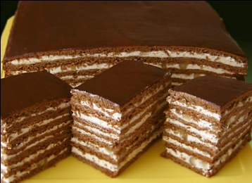
Tell me!

Slide 27
Tell me!

Slide 28
Tell me!

Slide 29
Tell me!

Slide 30
Tell me!

Slide 31
Tell me!

Slide 32
Tell me!

Slide 33
Tell me!

Slide 34
Tell me!

Slide 35
Tell me!

Slide 36
Tell me!

Slide 37
Tell me!

Slide 38
Tell me!

Slide 39
Tell me!

Slide 40
Tell me!
CLOSED!

Slide 41
Good-Bye!

